Slide 1
Meeting 29

Slide 2
Tasks
Fit occurrence model with different thresholds
Fit amount model with re-arranged likelihood function
Re run the optimiser with set.seed()
Plot changes in parameters of each trial

Slide 3
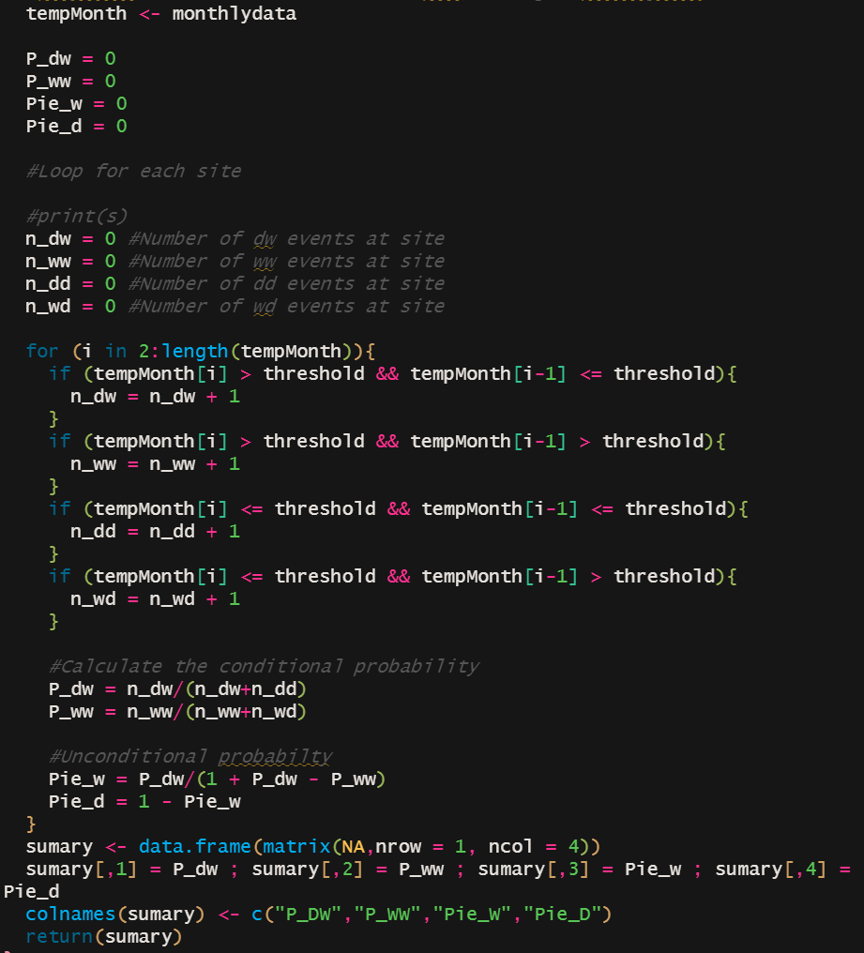
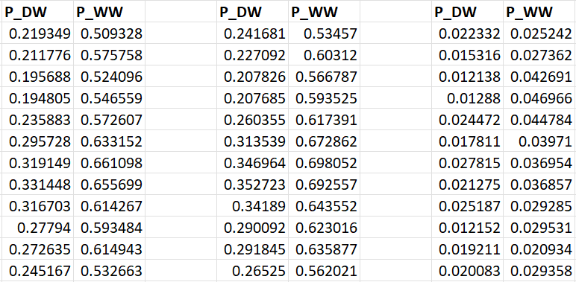
Occurrence model
Threshold = 0.1
Threshold = 0
Difference

Slide 4
Occurrence model
Threshold = 0.1
Threshold = 0
Difference

Slide 5
Amount model
For shape and scale
Same result
ƅ
1/ƅ
For shape and rate

Slide 6
Plan
Fix amount parameters then calibrate with occurrence parameters. Comparing the results.
Calibrate and validate
Implement a different objective function
Add more get stats functions (annual total rainfall, annual wet day amount, monthly total flow, annual total flow)

